Slide 1
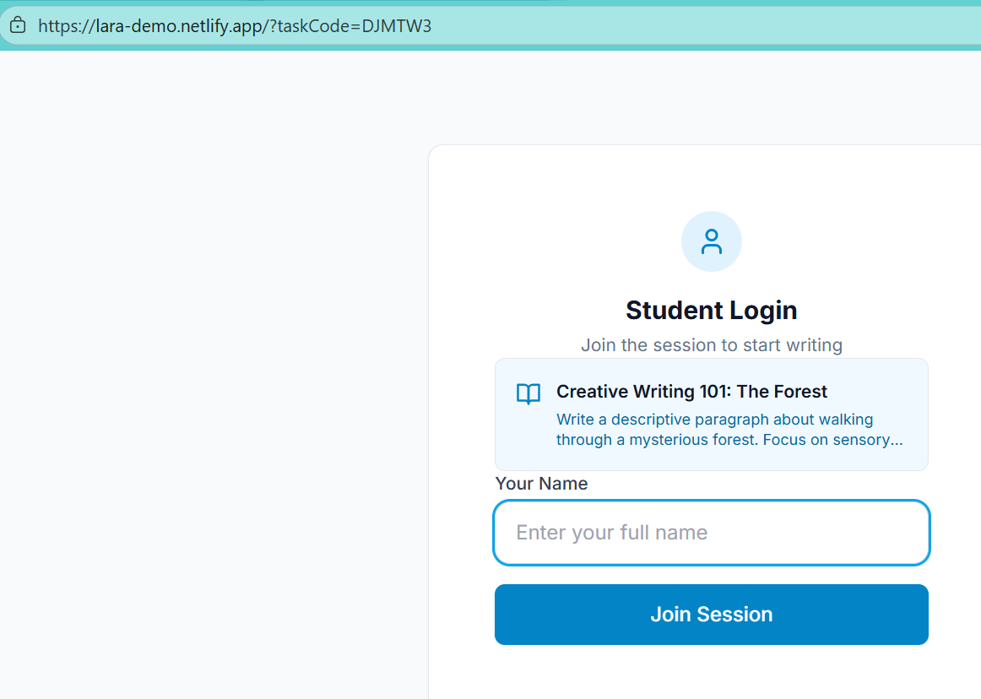
Your name AND Enter your full name – misleading. Student Code STUDENT
This page leaks task content before students have meaningfully joined, creating confusion around session control, identity, and assessment integrity.
The task title and description are visible before the student has joined the session. AND it undermines the logic of the page. This page behaves like a task preview, not a secure entry point. Task content should only appear after a successful join.
Names don’t gate sessions, codes do. Something like Enter the code your teacher gave you (for example: 9A01)

Slide 2
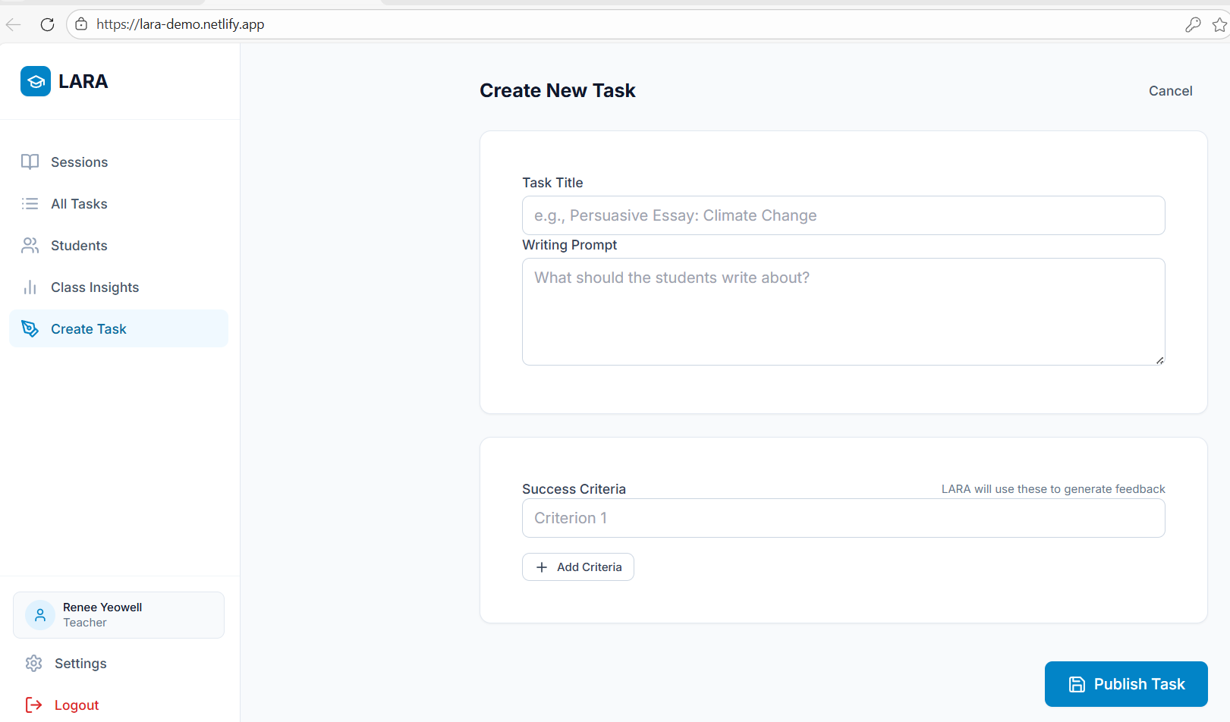
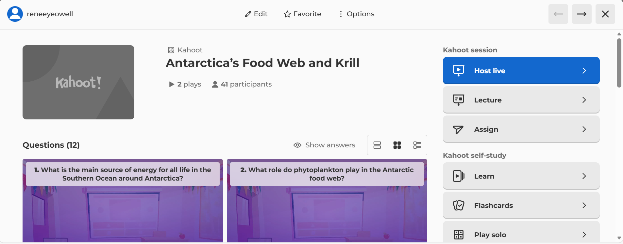
Host Live is what a teacher would need to click to start a live session. In LARA the Publish Task would appear to work well so no need to change anything in the publishing of the task.

Slide 3
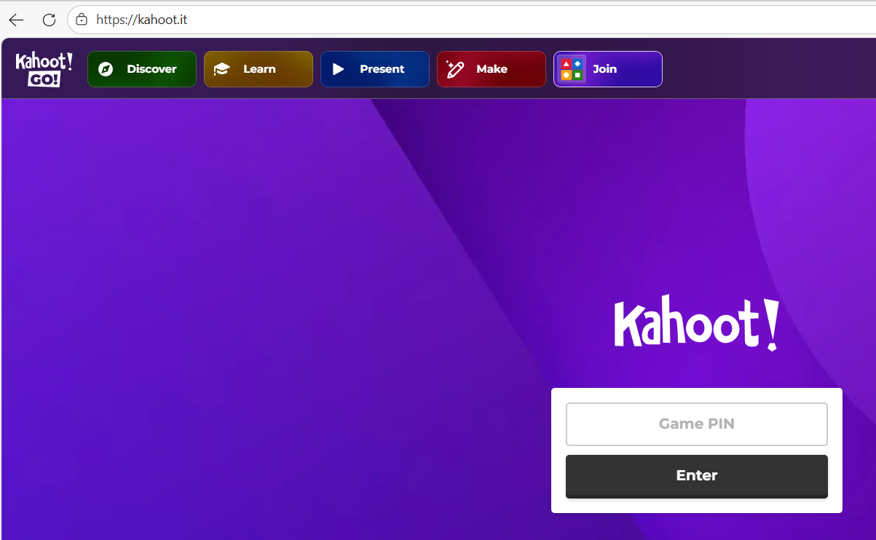
Kahoot.it
Consider LARA colours – Edberg Education Brand Details.pdf

Slide 4
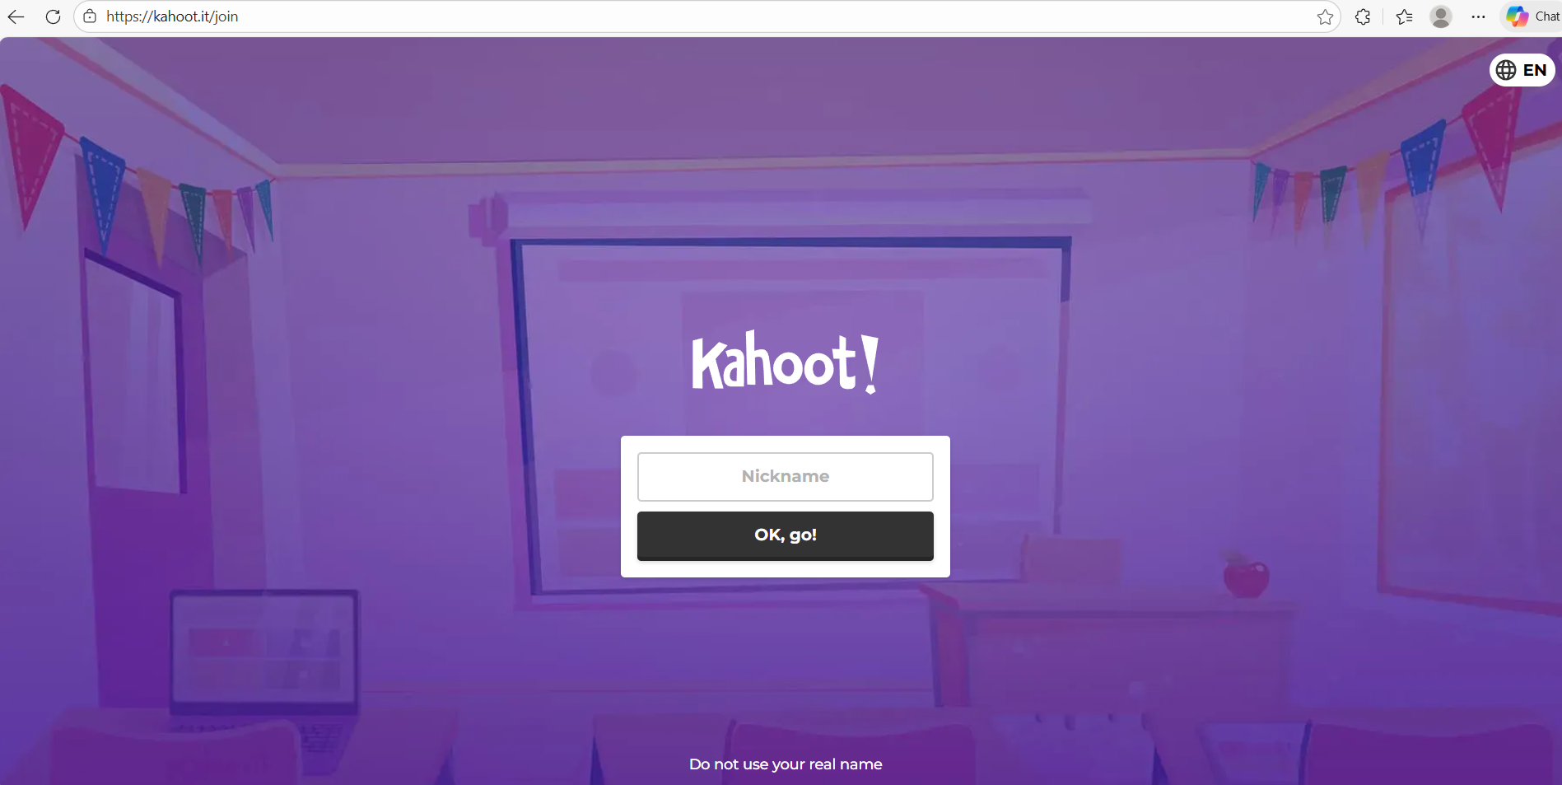
VERY IMPORTANT. Enter the code your teacher gave you (for example: 9A01)

Slide 5
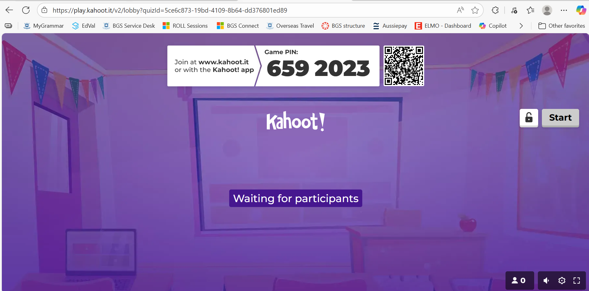
Whilst, LARA doesn’t need to wait for all students to start at the same time…the advantage of doing so is that it allows for teachers to pick up if a) teachers are using incorrect code OR – more likely b) inappropriate names

Slide 6
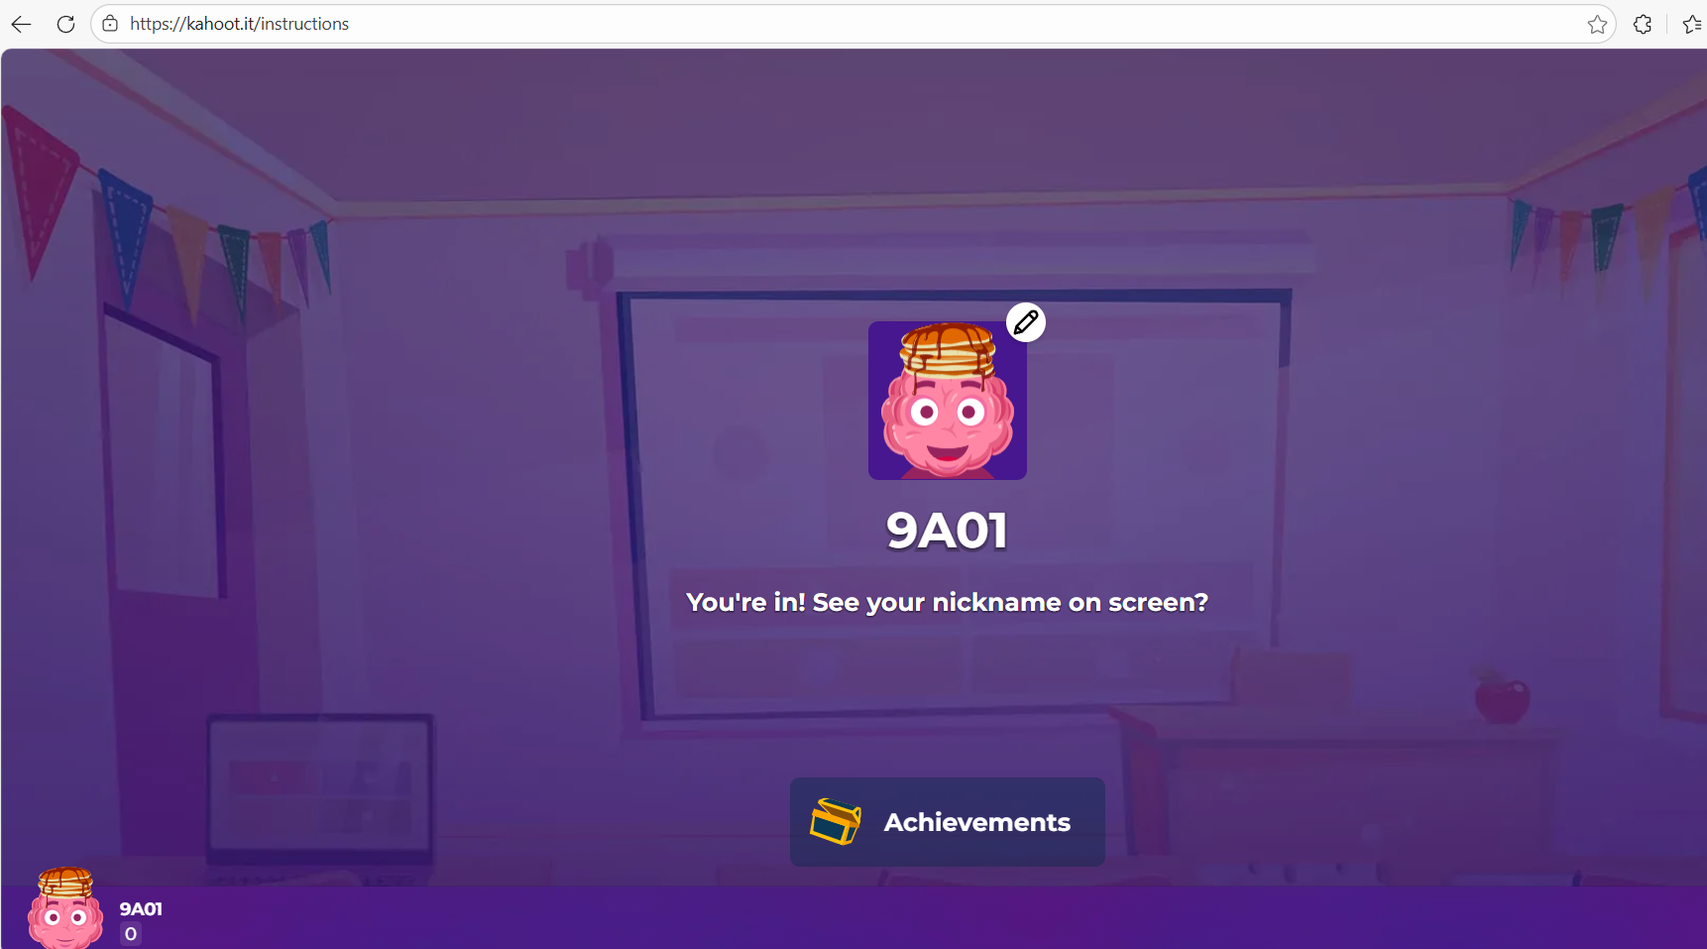
Once in and name checked by teacher they can see task and begin writing

Slide 7
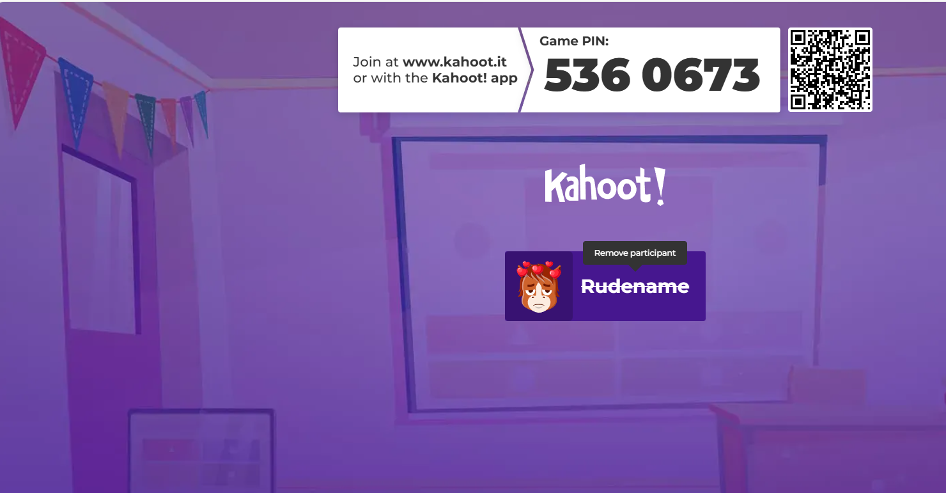
If teacher hoovers over name option to remove learner (use this language)

Slide 8
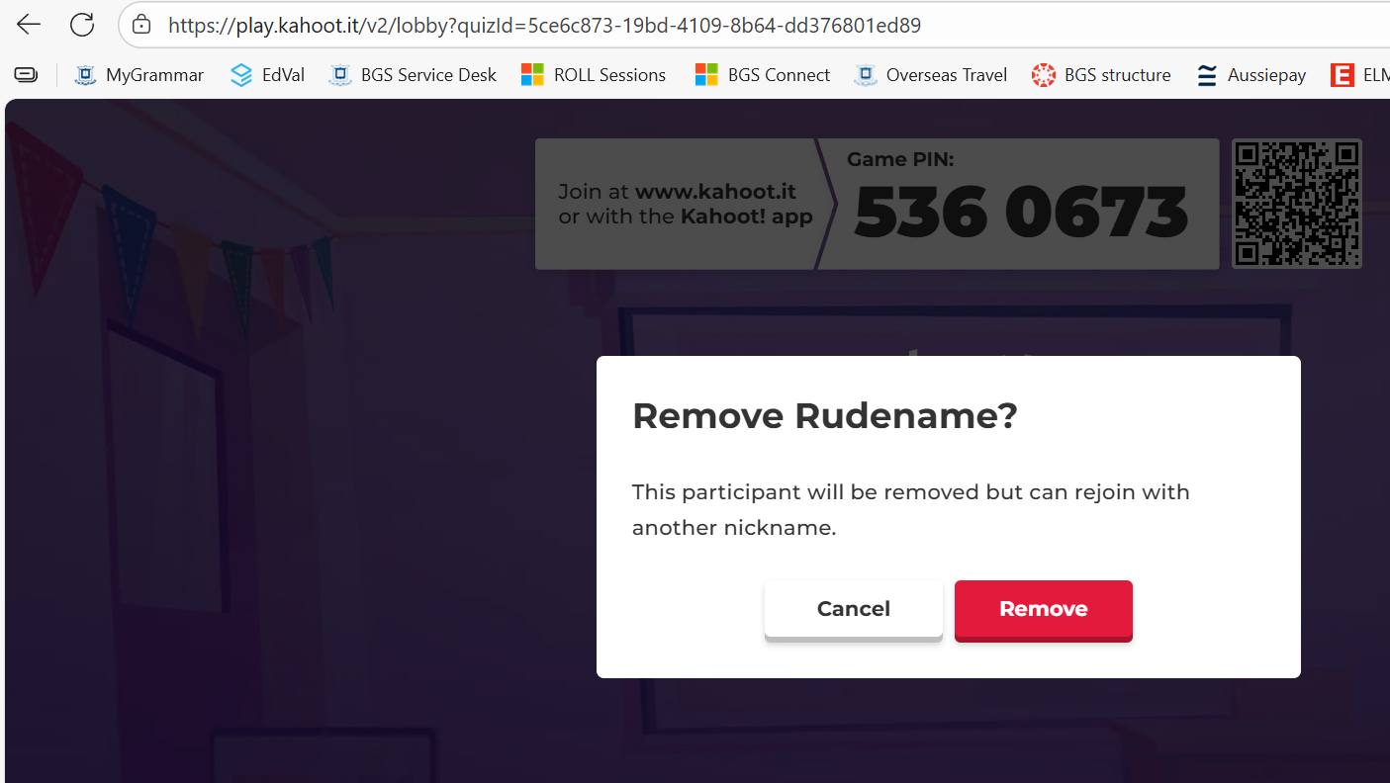
Warning before click to remove
LEARNER

Slide 9
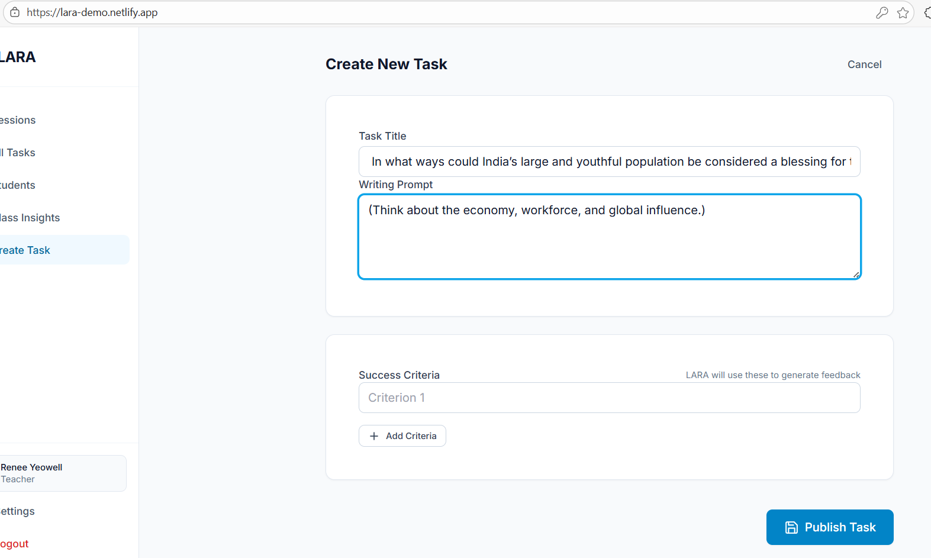
Ability to add jpeg/ png to question?
Use Universal Learning Expections – I think I will need a space on front page somewhere to explain what these are – this is LARA unique point

Slide 10
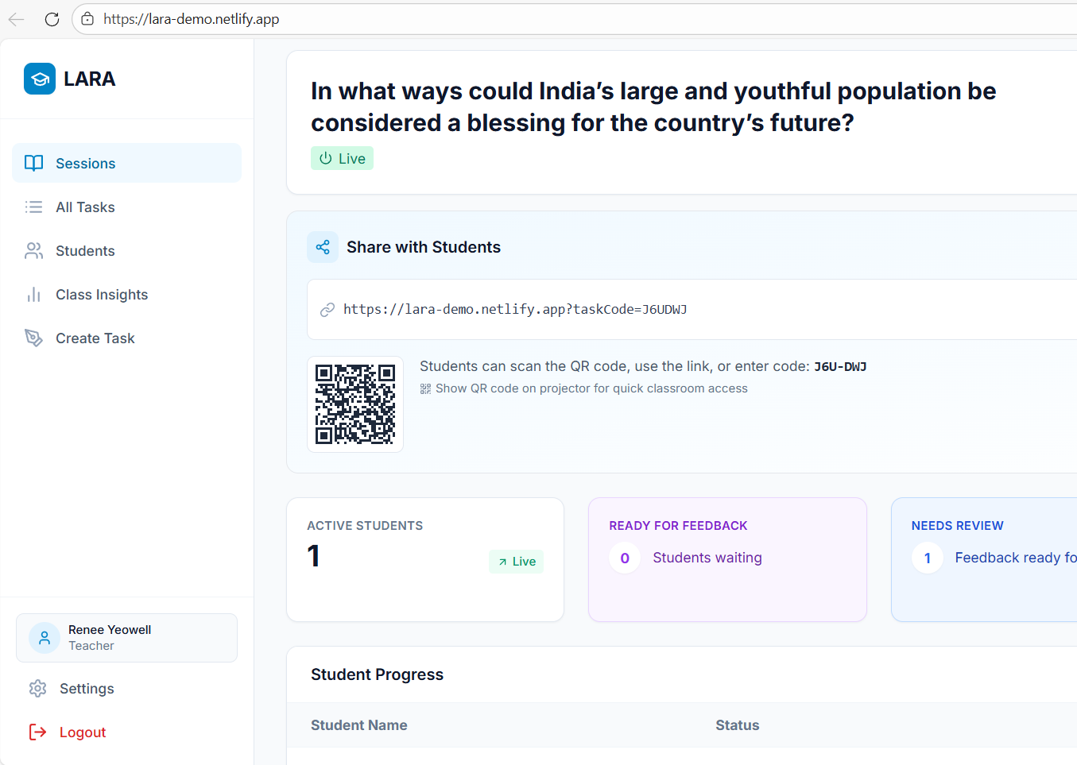
Once student enters code – teacher needs to refresh for them to appear. Needs to be automatic

Slide 11
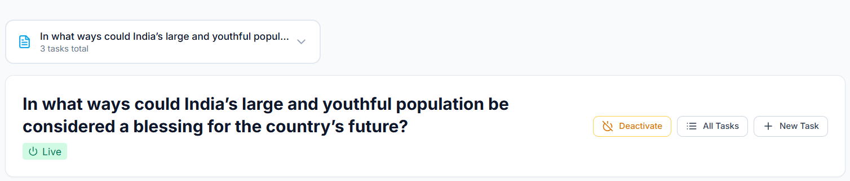
Question v Success Criteria
EDIT TASK (essential)
Success Criteria I used: Analyse how a country’s population size and composition impact economy, workforce and global influence)
The feedback came back as missing looking at different sizes and composition. In this case my success criteria did not align with my question and therefore if I had followed the feedback I would not have ATQ – answered the question. We need to consider how we back sure the teacher is using success criterias that allow Claude to succeed. Thoughts? If feedback is based from the success criteria (and not question we need to think pause to consider the implications)

Slide 12
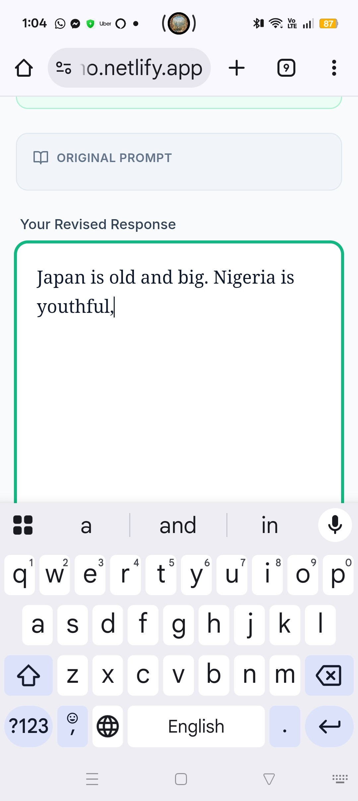
Student after receiving feedback:
Once student has selected their chosen feedback. Their original text should reappear so they can add/ refine or if they choose to delete and start again. Students are not resilient and will not want to start completely again.

Slide 13
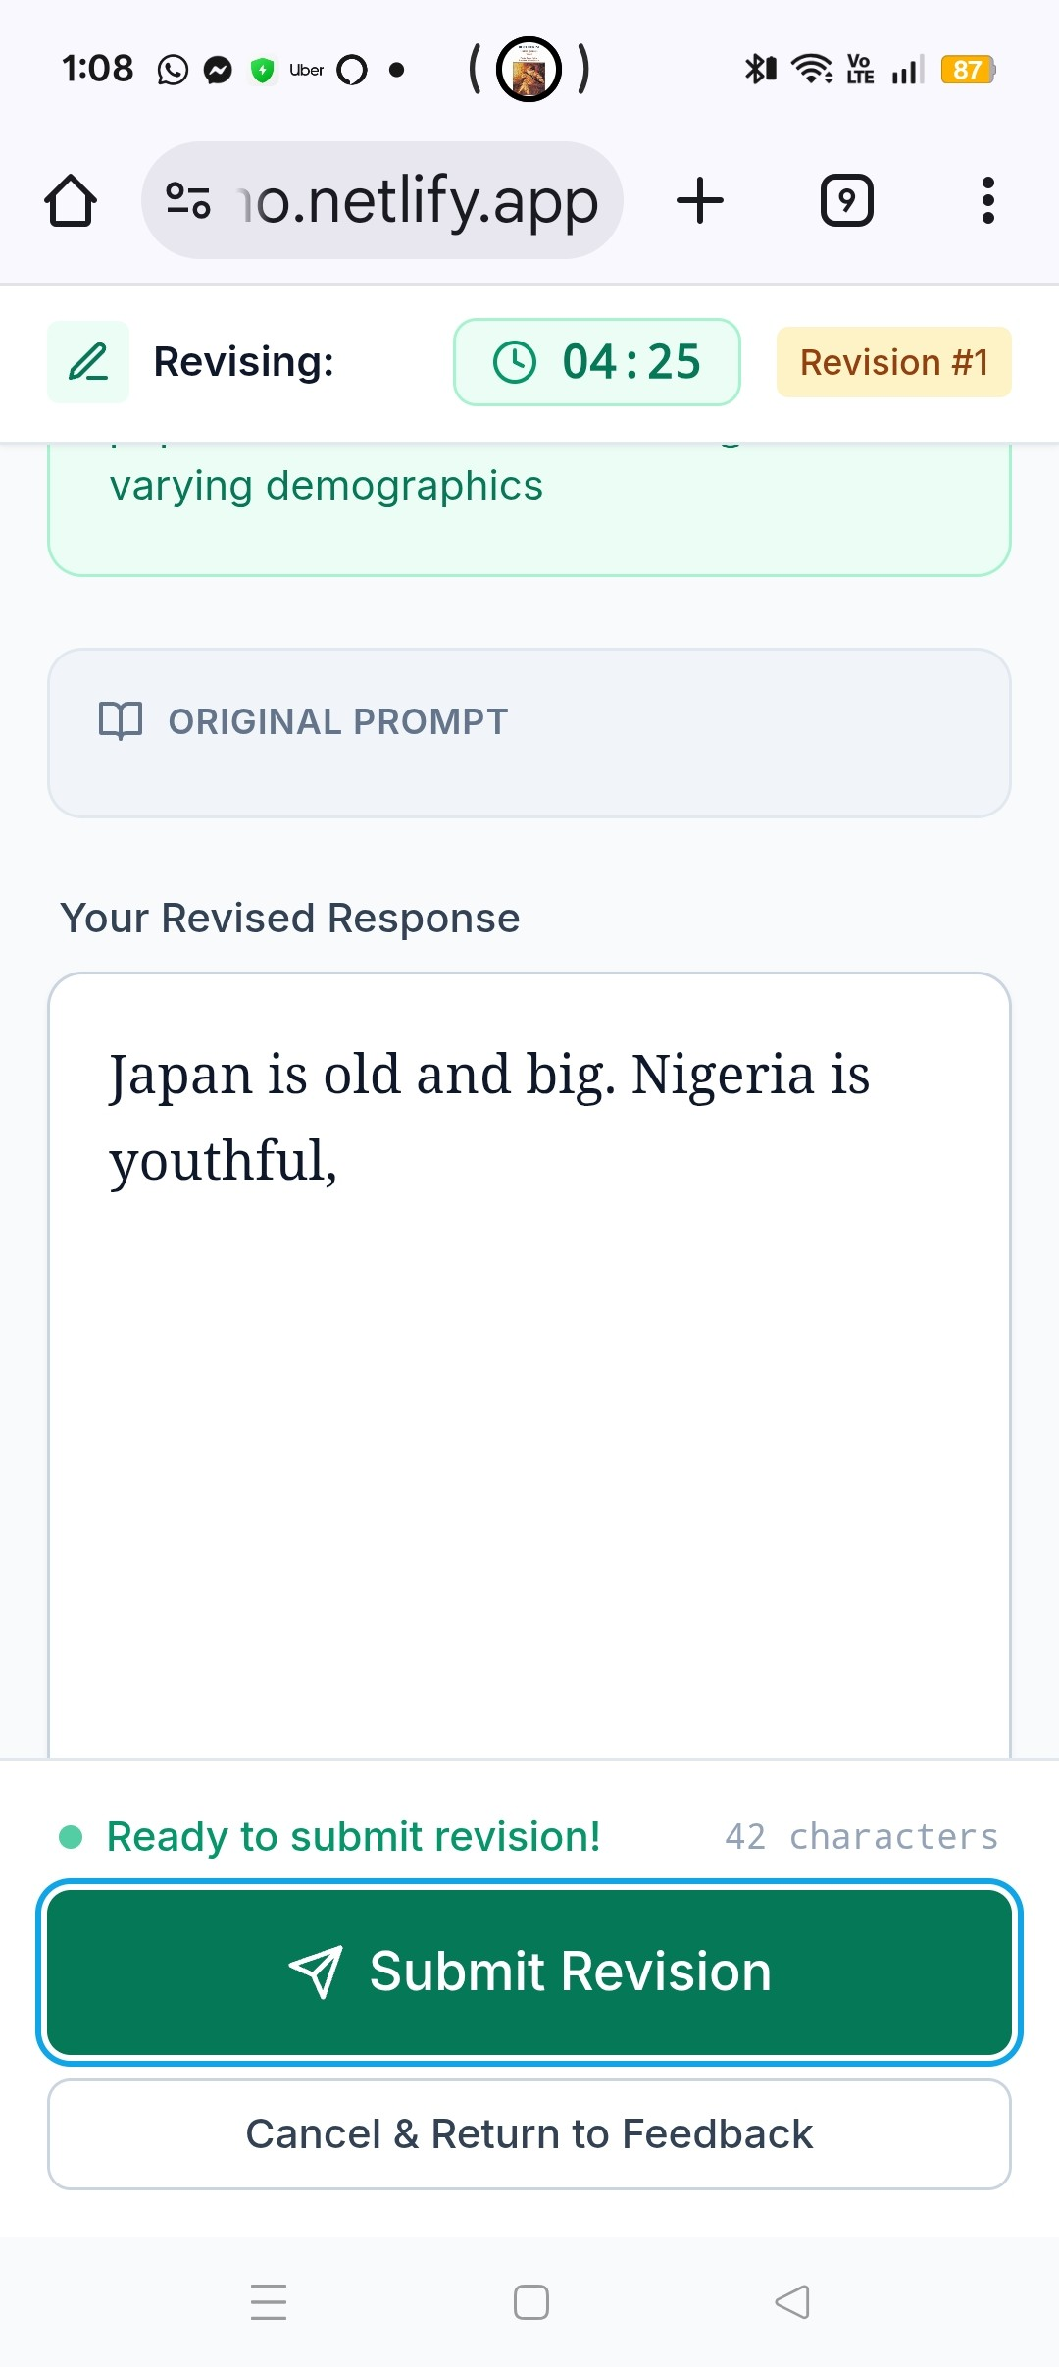
After refining ‘submit revision’
Read student interface p24 – 32
MVP1 Technical Blueprint 19122025.pdf

